Slide 1
TxCRCP-ME Interface https://idatavisualizationlab.github.io/txDoT/
01/08/2021
Pavement Analysis & Design – MNT

Slide 2
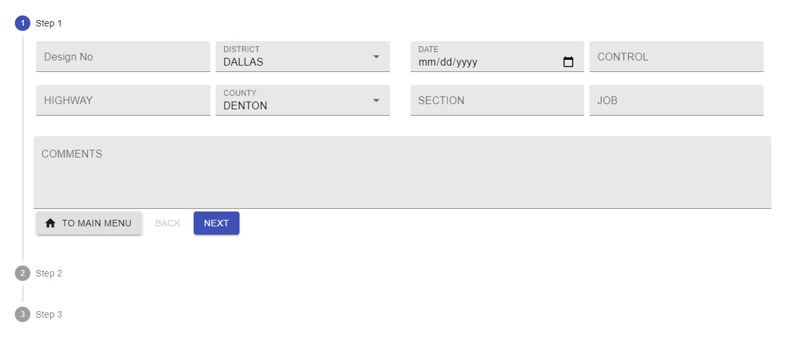

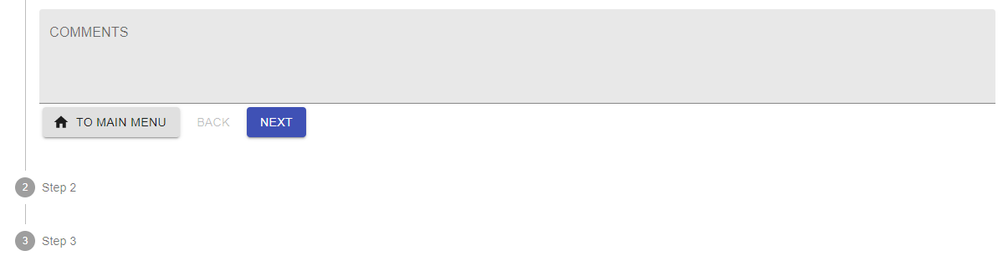
Step 1
Rearrange input boxes and add project scope box
DISTRICT
COUNTY
HIGHWAY
DIRECTION OF CONSTRUCTION
CONTROL
SECTION
JOB
WIDENING
REHABILITATION
NEW CONSTRUCTION
STATION (BEGIN)
STATION (END)
Dropdown menu
Future Plan
We will include
Basic requirements of New Construction & Widening
Forensic evaluations for Rehabilitation

Slide 3
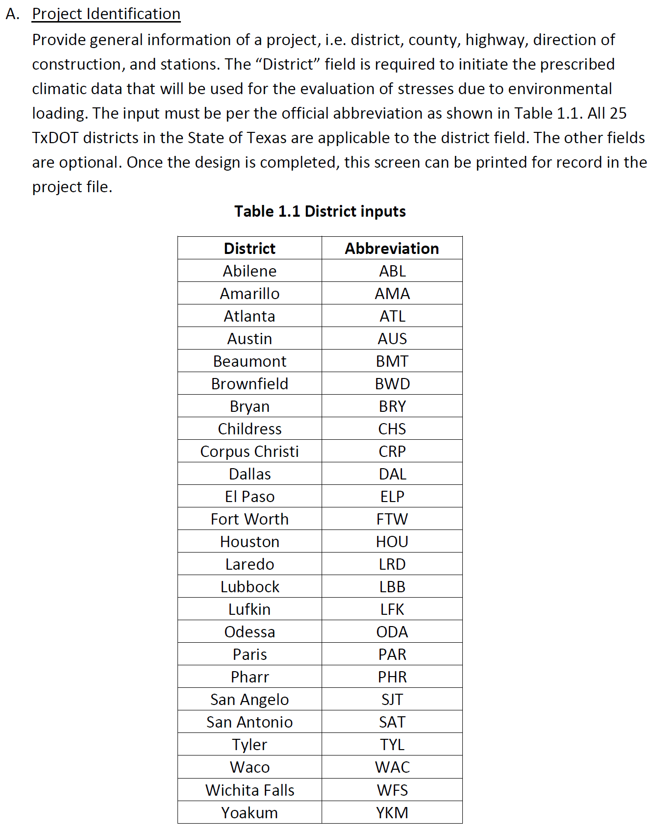
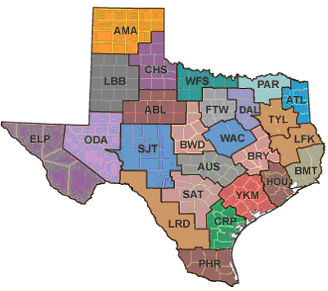
Step 1 – Help Function
DISTRICT
COUNTY
HIGHWAY
DIRECTION OF CONSTRUCTION
CONTROL
SECTION
JOB
WIDENING
REHABILITATION
NEW CONSTRUCTION
STATION (BEGIN)
STATION (END)
Dropdown menu

Slide 4
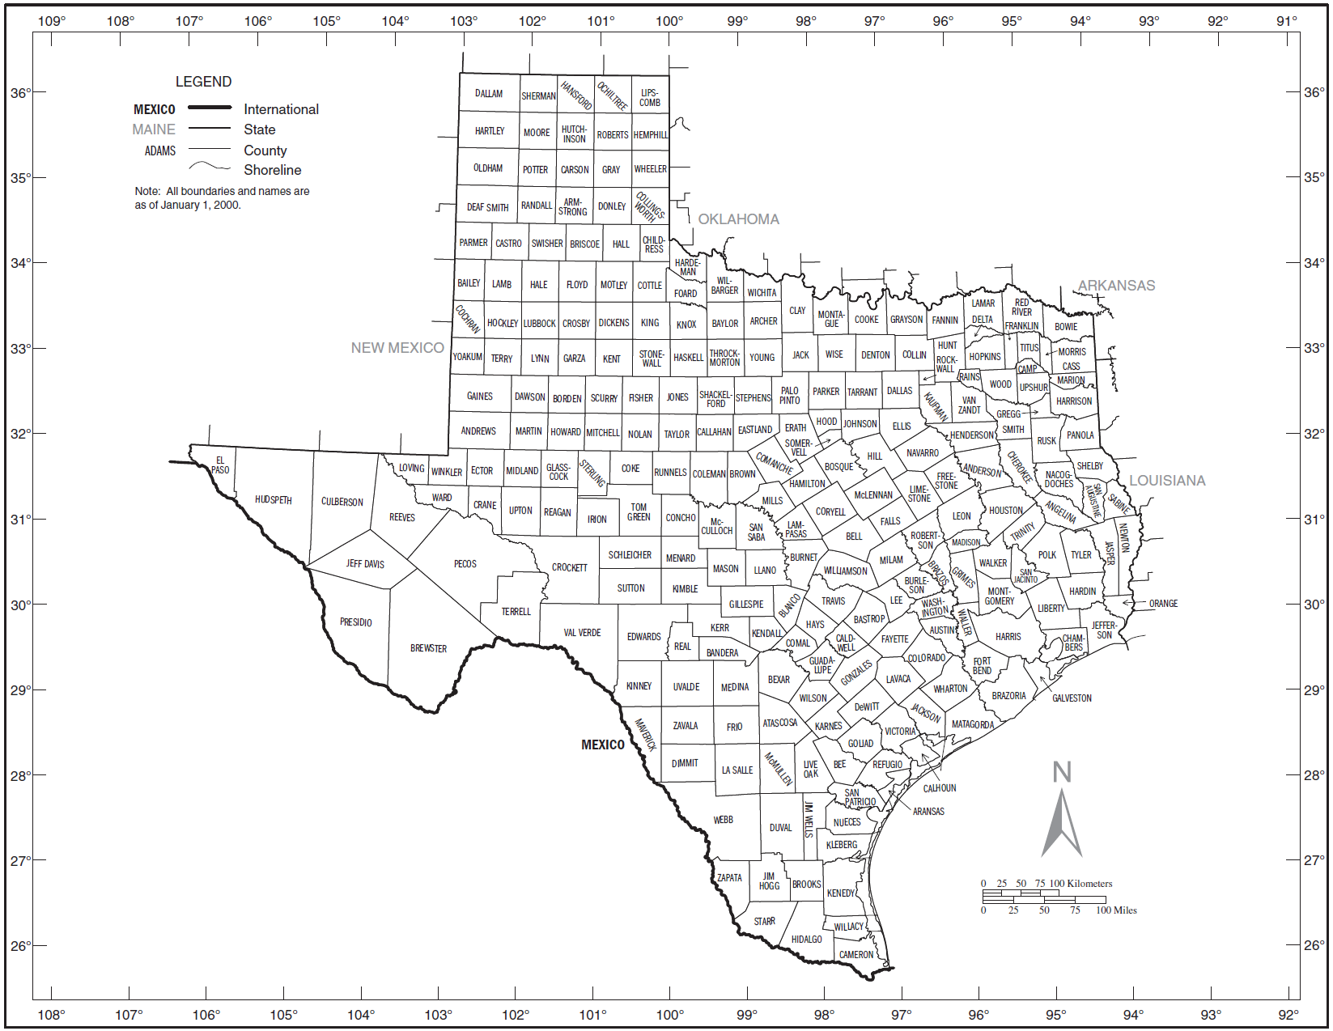
Step 1 – Help Function
DISTRICT
COUNTY
HIGHWAY
DIRECTION OF CONSTRUCTION
CONTROL
SECTION
JOB
WIDENING
REHABILITATION
NEW CONSTRUCTION
STATION (BEGIN)
STATION (END)
Future Plan
We will include
Basic requirements of New Construction & Widening
Forensic evaluations for Rehabilitation

Slide 5
Step 1 – Help Function
DISTRICT
COUNTY
HIGHWAY
DIRECTION OF CONSTRUCTION
CONTROL
SECTION
JOB
WIDENING
REHABILITATION
NEW CONSTRUCTION
STATION (BEGIN)
STATION (END)
Dropdown menu
Will be provided later.

Slide 6
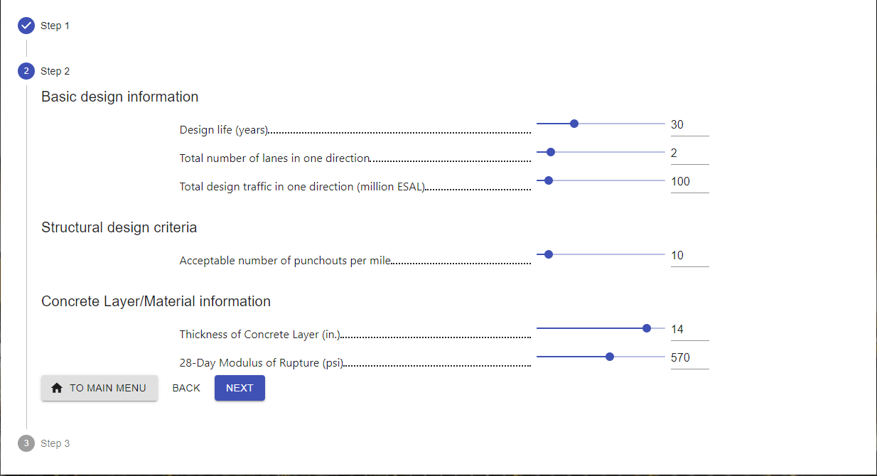
Step 2
We don’t wat to include slab thickness as an input. Design thickness should be calculated automatically.

Slide 7
Step 2
STEP 2
Basic Design Information
Design life (years)
Total Number of Lanes in One Direction
Total Design Traffic in One Direction (million ESAL)
Structural Design Criteria
Acceptable Number of Punchouts per Lane Mile
Concrete Layer/Material Information
28-Day Modulus of Rupture (psi)
Concrete Elasticity of Modulus (million psi)
Coefficient of Thermal Expansion (10⁻⁶/^{O}F)
FIXED
FIXED
FIXED
FIXED

Slide 8
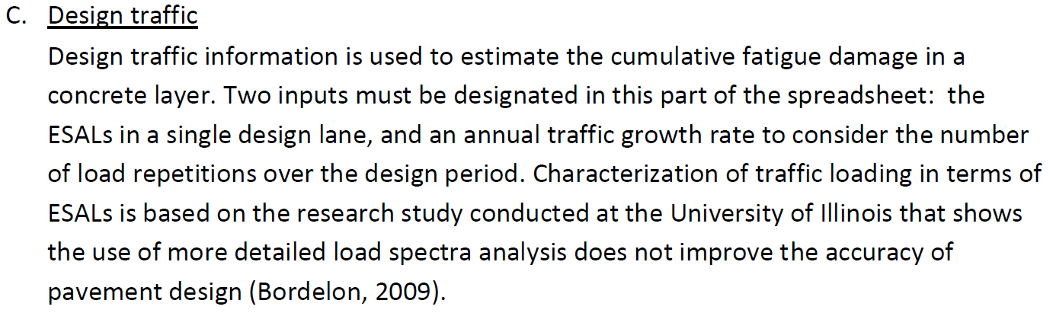
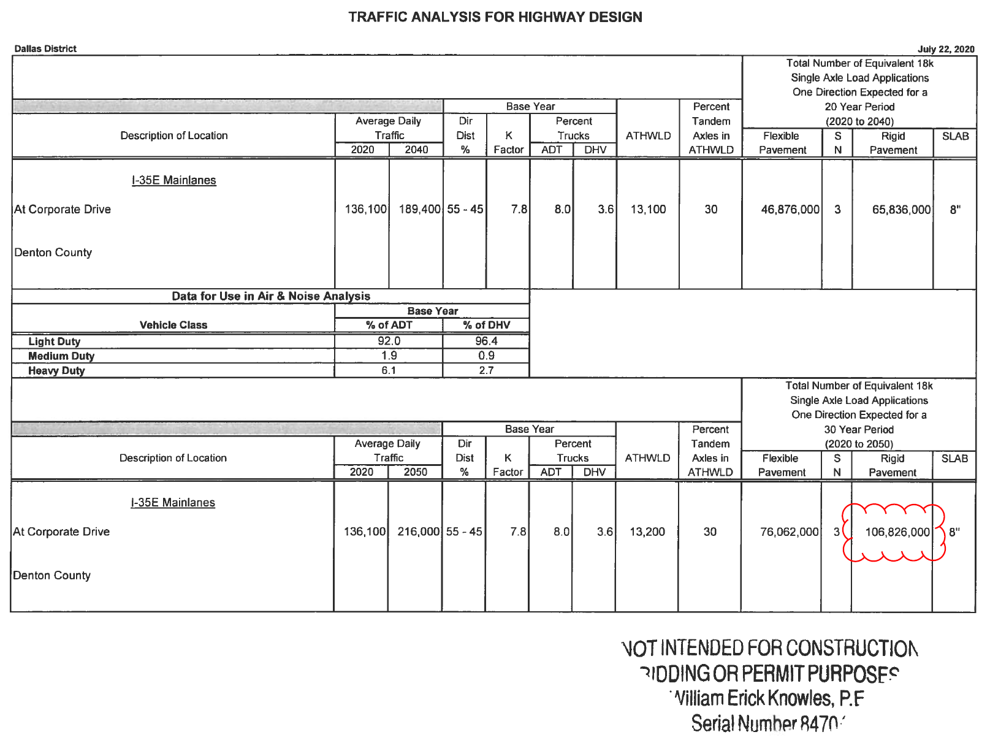
Step 2 – Help Function
STEP 2
Basic Design Information
Design life (years)
Total Number of Lanes in One Direction
Total Design Traffic in One Direction (million ESAL)
Structural Design Criteria
Acceptable Number of Punchouts per Lane Mile
Concrete Layer/Material Information
28-Day Modulus of Rupture (psi)
Concrete Elasticity of Modulus (million psi)
* Use Form 2124 for traffic data request
: Transportation Planning and Programming Division
Traffic Analysis for Highway Design
http://txeform/txdoteforms/GetForm?formName=/2124.pdf&appID=/TPP&status=/reportError.jsp&configFile=WFServletConfig.xml
FIXED
FIXED
FIXED

Slide 9
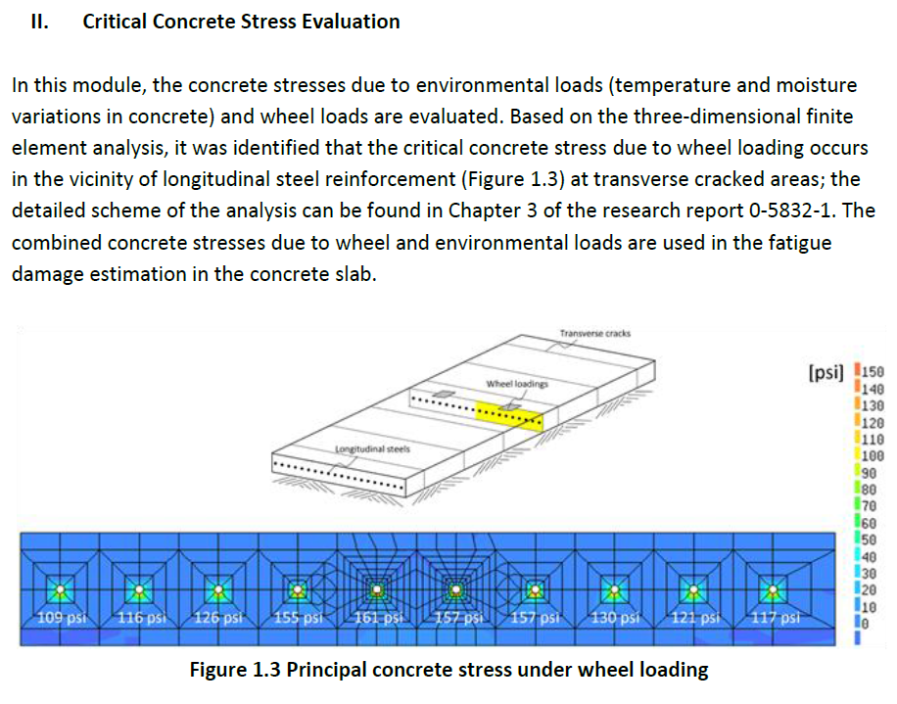
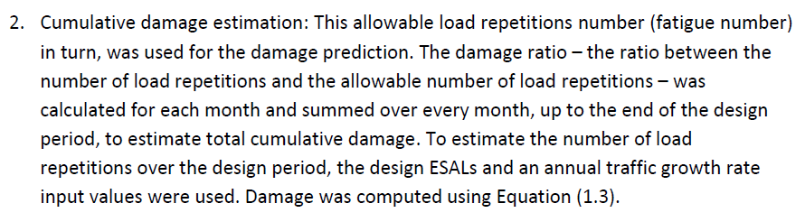
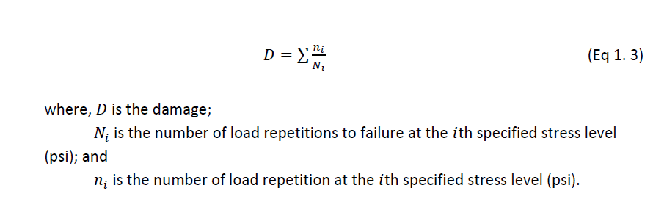
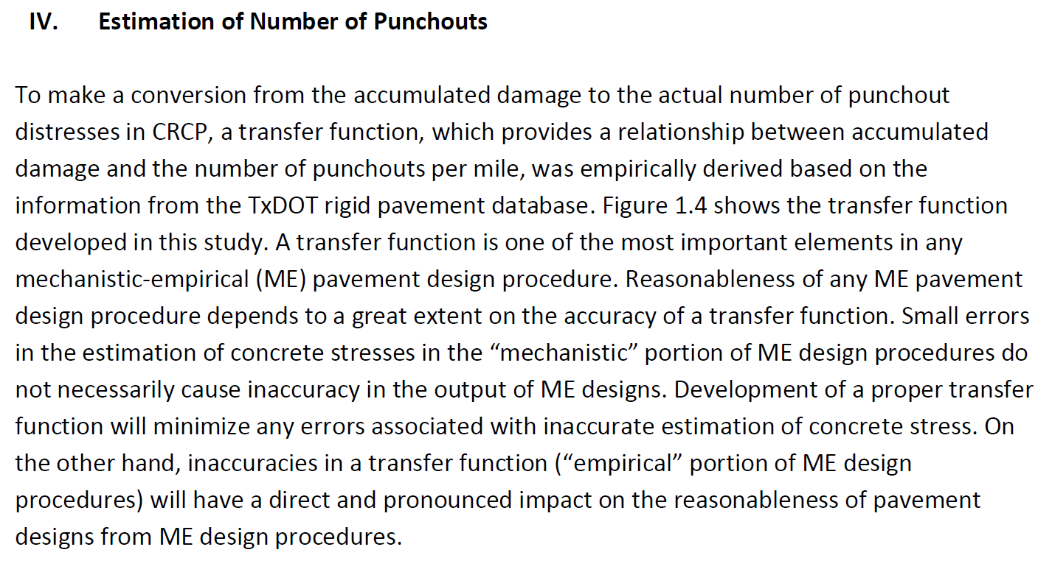
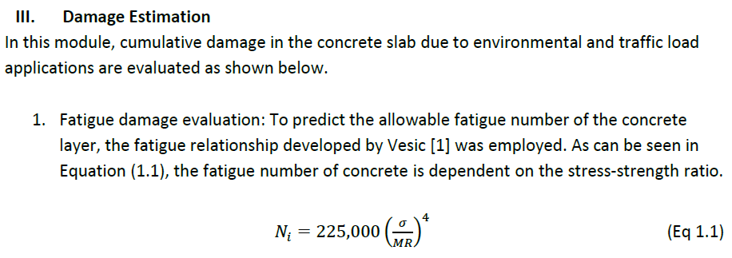
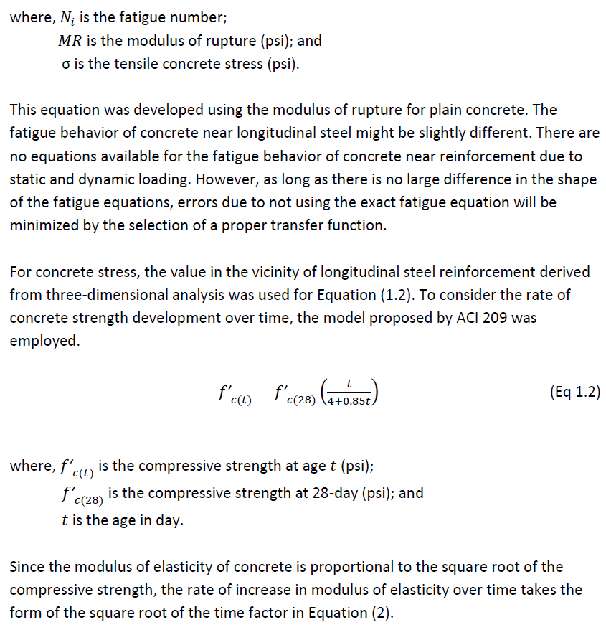
Step 2 – Help Function
STEP 2
Basic Design Information
Design life (years)
Total Number of Lanes in One Direction
Total Design Traffic in One Direction (million ESAL)
Structural Design Criteria
Acceptable Number of Punchouts per Lane Mile
Concrete Layer/Material Information
28-Day Modulus of Rupture (psi)
Concrete Elasticity of Modulus (million psi)
FIXED
FIXED
FIXED

Slide 10
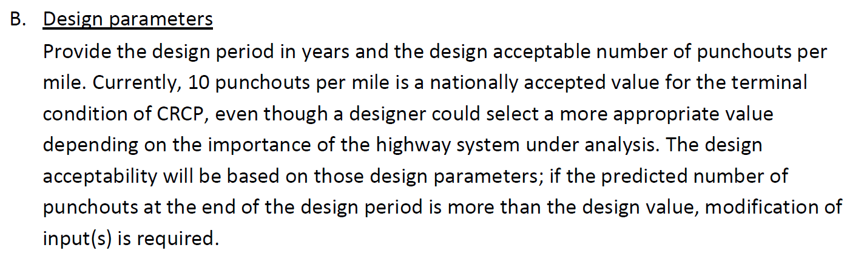
Step 2 – Help Function
STEP 2
Basic Design Information
Design life (years)
Total Number of Lanes in One Direction
Total Design Traffic in One Direction (million ESAL)
Structural Design Criteria
Acceptable Number of Punchouts per Lane Mile
Concrete Layer/Material Information
28-Day Modulus of Rupture (psi)
Concrete Elasticity of Modulus (million psi)
FIXED
FIXED
FIXED

Slide 11
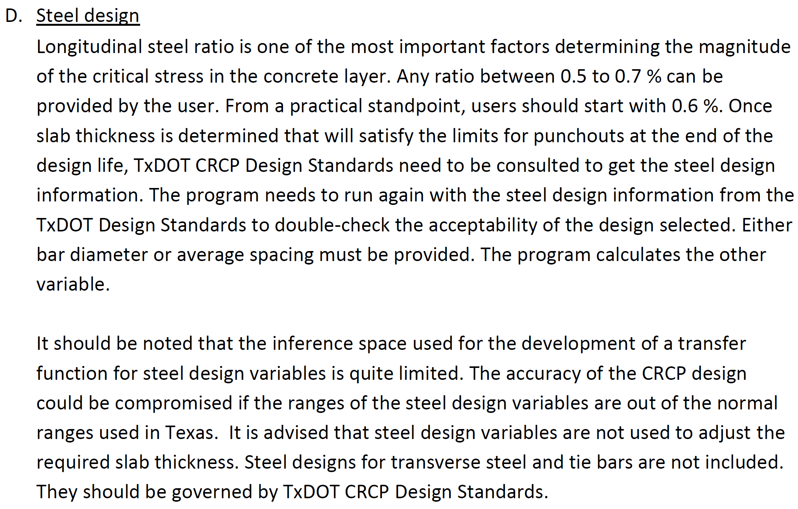
Step 2 – Help Function
STEP 2
Basic Design Information
Design life (years)
Total Number of Lanes in One Direction
Total Design Traffic in One Direction (million ESAL)
Structural Design Criteria
Acceptable Number of Punchouts per Lane Mile
Concrete Layer/Material Information
28-Day Modulus of Rupture (psi)
Concrete Elasticity of Modulus (million psi)
FIXED
FIXED
FIXED

Slide 12
Step 3
STEP 3
Subgrade and Subbase Information
Soil Classification System
Soil Classification of Subgrade
Plasticity Index (PI)
Subbase Type
Subbase Layer Thickness (in.)
Base Layer Information
Base Type
Base Layer Thickness (in.)
Modulus of Base Layer (ksi)
Composite k-Value
Dropdown menu
GW/GP/GM/GC/SW/SP/SM/SC/ML/CL/OL/MH/CH/OH/Pt
USCS
Dropdown menu
Cement treated subgrade
Lime treated subgrade
Lime-cement treated subgrade
Lime-fly ash treated subgrade
Fly ash treated subgrade
Select Fill
N/A
Dropdown menu
CTB
HMA Base
Minimum Cap.
CTB ≥ 6.0 in.
HMA ≥ 4.0 in.
Derived value
Calculated value

Slide 13
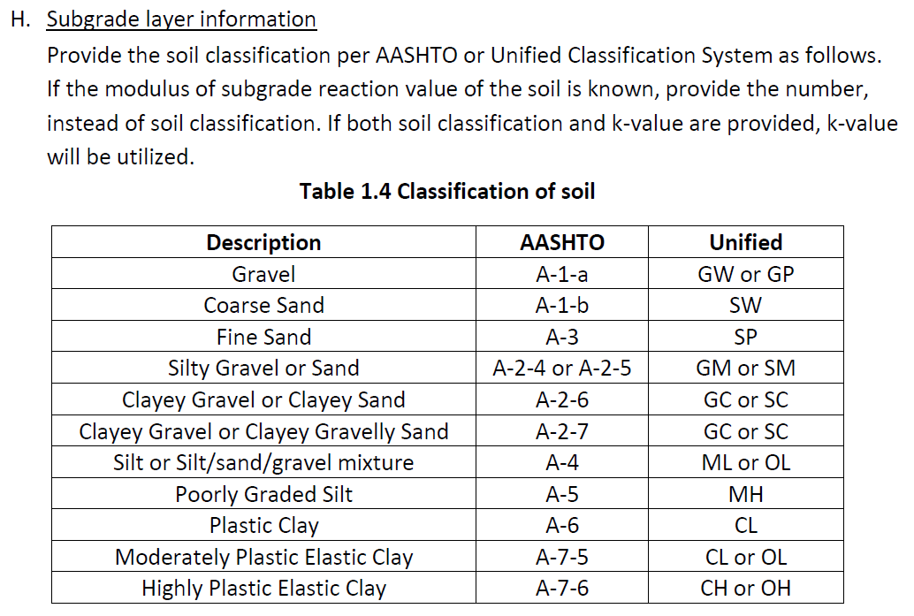
Step 3 – Help Function
STEP 3
Subgrade and Subbase Information
Soil Classification System
Soil Classification of Subgrade
Plasticity Index (PI)
Subbase Type
Subbase Layer Thickness (in.)
Base Layer Information
Base Type
Base Layer Thickness (in.)
Modulus of Base Layer (ksi)
Composite k-Value
USCS

Slide 14
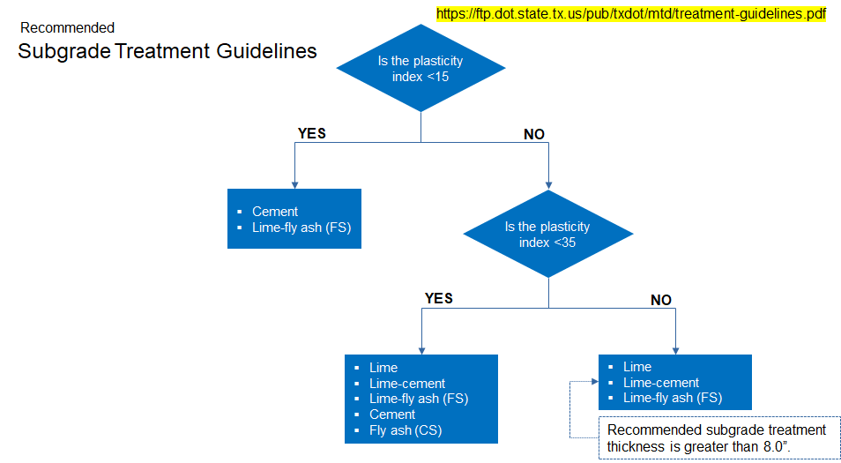
Step 3 – Help Function
STEP 3
Subgrade and Subbase Information
Soil Classification System
Soil Classification of Subgrade
Plasticity Index (PI)
Subbase Type
Subbase Layer Thickness (in.)
Base Layer Information
Base Type
Base Layer Thickness (in.)
Modulus of Base Layer (ksi)
Composite k-Value
USCS

Slide 15
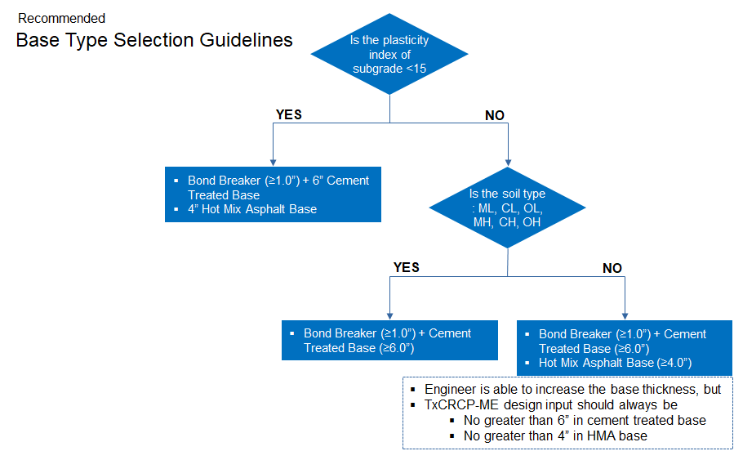
Step 3 – Help Function
STEP 3
Subgrade and Subbase Information
Soil Classification System
Soil Classification of Subgrade
Plasticity Index (PI)
Subbase Type
Subbase Layer Thickness (in.)
Base Layer Information
Base Type
Base Layer Thickness (in.)
Modulus of Base Layer (ksi)
Composite k-Value
USCS

Slide 16
Step 3 – Help Function
STEP 3
Subgrade and Subbase Information
Soil Classification System
Soil Classification of Subgrade
Plasticity Index (PI)
Subbase Type
Subbase Layer Thickness (in.)
Base Layer Information
Base Type
Base Layer Thickness (in.)
Modulus of Base Layer (ksi)
Composite k-Value
USCS
Minimum Cap.
CTB ≥ 6.0 in.
HMA ≥ 4.0 in.

Slide 17
Step 3 – Help Function
STEP 3
Subgrade and Subbase Information
Soil Classification System
Soil Classification of Subgrade
Plasticity Index (PI)
Subbase Type
Subbase Layer Thickness (in.)
Base Layer Information
Base Type
Base Layer Thickness (in.)
Modulus of Base Layer (ksi)
Composite k-Value
USCS
CTB = 500 ksi
HMA base = 400 ksi

Slide 18
Step 3 – Help Function
STEP 3
Subgrade and Subbase Information
Soil Classification System
Soil Classification of Subgrade
Plasticity Index (PI)
Subbase Type
Subbase Layer Thickness (in.)
Base Layer Information
Base Type
Base Layer Thickness (in.)
Modulus of Base Layer (ksi)
Composite k-Value
USCS
Composite k table

Slide 19
Additional Discussion – Subgrade Treatment Guidelines
Once engineer selects subgrade type, recommended subgrade treatment guidelines should be popped up.
Recommended
Subgrade Treatment Guidelines
https://ftp.dot.state.tx.us/pub/txdot/mtd/treatment-guidelines.pdf
Is the plasticity index <15
YES
NO
Cement
Lime-fly ash (FS)
Is the plasticity index <35
YES
NO
Lime
Lime-cement
Lime-fly ash (FS)
Cement
Fly ash (CS)
Lime
Lime-cement
Lime-fly ash (FS)
Recommended subgrade treatment thickness is greater than 8.0”.

Slide 20
Additional Discussion – Base Type Selection Guidelines
If the soil types are ML, CL, OL, MH, CH, and OH, a recommended base type should be Cement Treated Base.
Recommended
Base Type Selection Guidelines
Is the plasticity index of subgrade <15
YES
NO
Bond Breaker (≥1.0”) + 6” Cement Treated Base
4” Hot Mix Asphalt Base
Is the soil type
: ML, CL, OL, MH, CH, OH
YES
NO
Bond Breaker (≥1.0”) + Cement Treated Base (≥6.0”)
Bond Breaker (≥1.0”) + Cement Treated Base (≥6.0”)
Hot Mix Asphalt Base (≥4.0”)
Engineer is able to increase the base thickness, but
TxCRCP-ME design input should always be
No greater than 6” in cement treated base
No greater than 4” in HMA base

Slide 21
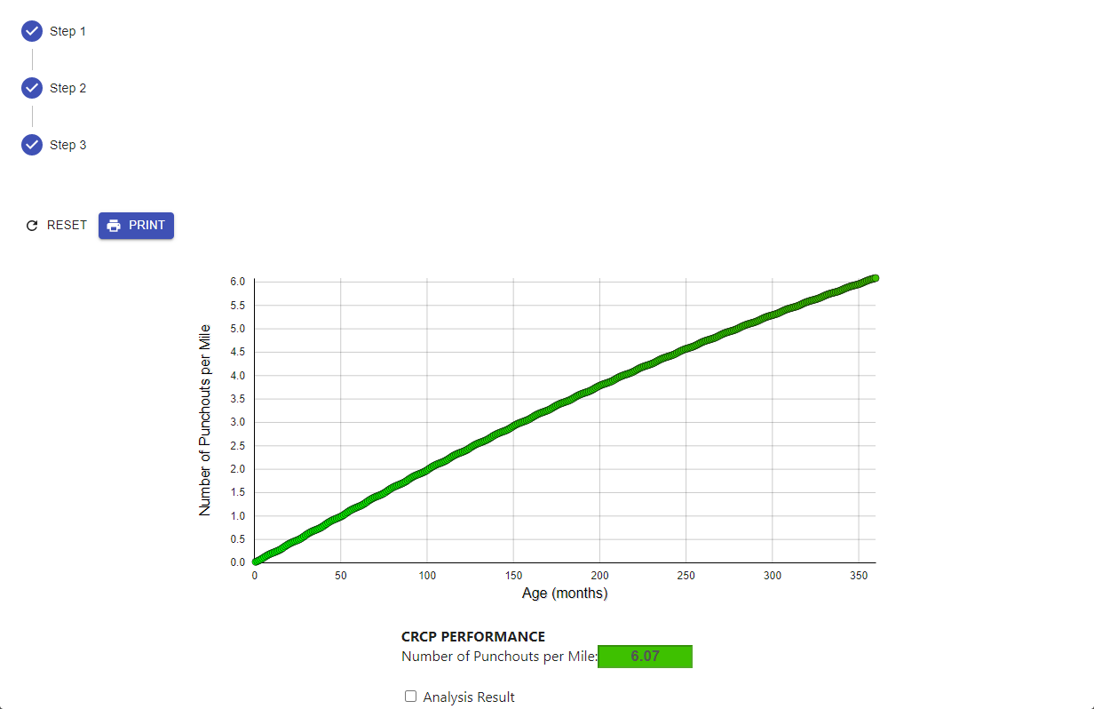

Analysis Result – PDF File to be Used in Pavement Design Report
PDF file should be created in order to include the analysis result in the pavement design report.
Result
ANALYSIS RESULT
HOME

Slide 22
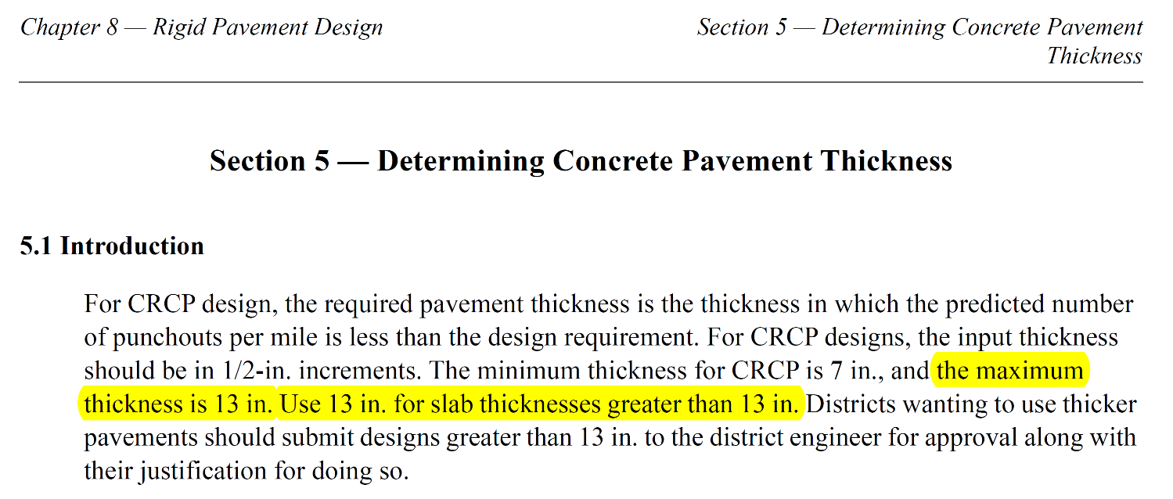
Slab Thickness Cap.
If the design thickness from TxCRCP-ME is greater than 13.0 in., the following contents will be popped up.
The minimum thickness for CRCP is 7 in., and the maximum thickness is 13 in.
Use 13 in. for slab thicknesses greater than 13 in.
Districts should use 13-in. slab as a design slab thickness. Districts wanting to use thicker pavements should submit design greater than 13-in. to the district engineer for approval along with their justification for doing so.

Slide 23
Recommended – Should be included in Pavement Design Report
Result
ANALYSIS RESULT
HOME
Once engineer clicks ‘ANALYSIS RESULT’, punchout graph and table will be popped up.

